Slide 1


Structure Mapping for Transferability of Causal Models
Purva Pruthi
University of Massachusetts Amherst
ppruthi@umass.edu
Xiaoyu Lu
Amazon
Cambridge, UK
luxiaoyu@amazon.com
Javier González
Microsoft
Cambridge, UK Gonzalez.Javier@microsoft.com
Madalina Fiterau
University of Massachusetts
Amherst
mfiterau@cs.umass.edu
ICML 2020 workshop on Inductive Biases, Invariances and Generalization in RL (BIG)

Slide 2


Reinforcement Learning and Causal Models
Role of Abstract Causal Knowledge
Human beings use abstract causal concepts to transfer knowledge in similar domains [1].
Learning of explicit causal dynamics model provides advantage of re-using the causal knowledge to transfer to the variations of the environment.
Object-oriented representation attributes effects of different objects to the object’s characteristics rather than it’s specific location in the state space [2].
[1] Dolan, R. J. and Dayan, P. Goals and habits in the brain. Neuron, 80(2):312–325, 2013. [2] Diuk, C., Cohen, A., and Littman, M. L. An object-oriented representation for efficient reinforcement learning. In Proceedings of the 25th international conference on Machine Learning, pp. 240–247, 2008

Slide 3
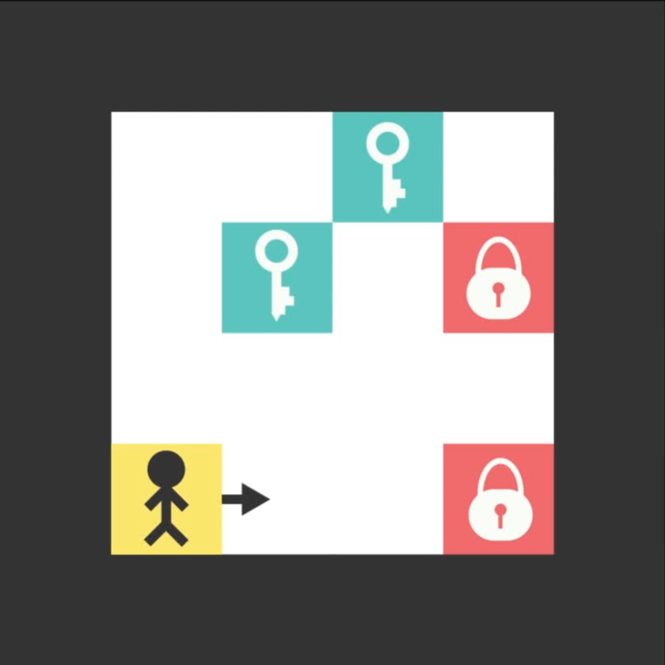

Toy Environment: Triggers [3]
Proof of Concept Environment
Figure 2 (a): Source Environment
Figure 2 (b): Target Environment
[3] Ferret, J., Marinier, R., Geist, M., and Pietquin, O. Self attentional credit assignment for transfer in reinforcement learning, 2019

Slide 4
Causal Structure Mapping
A transfer learning framework
Assumptions
Source and Target environments have same causal dynamics model but different perceptual features.
Environments are discrete and deterministic.
In source environment, agent can experiment with the environment by taking random actions while experiments in target environment are limited.
Object-oriented representation is learned from visual-objected reasoning modules and is already provided to us.
Transfer knowledge from source environment to target environment with minimal possible interventions in target environment and learn an optimal policy for target.
Objective

Slide 5
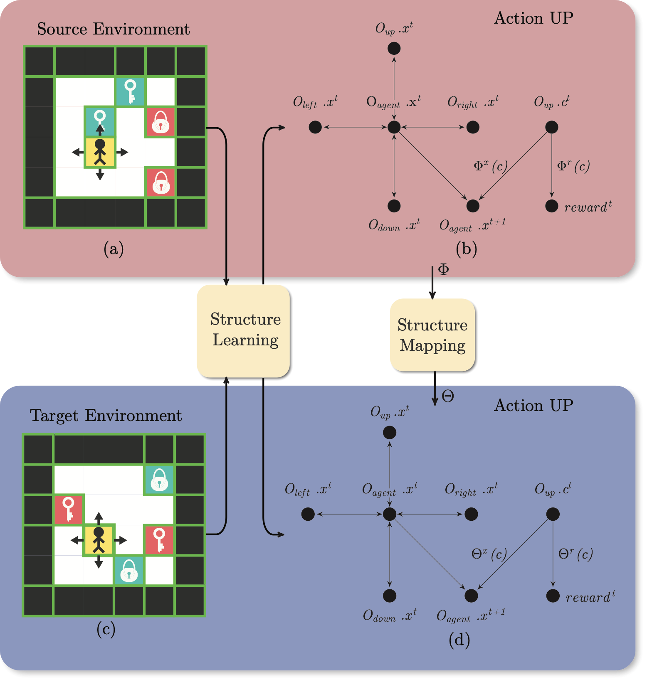
Approach
Structure Learning and Structure Mapping
Figure 3: High-level schematic diagram to illustrate the overall approach for transfer learning

Slide 6
Structure Learning in Object Oriented MDPs
Continuous Optimization for structure learning [4][5]
Objective: Learn a DAG $G^{a}(Φ)$ by learning $f=(f_{1},f_{2},f_{3}…f_{d})$.
We assume that $f_{j}$ is a function approximated by neural networks using the parameters $Φ_{j}$.
Where $W(f)=W(f_{1},f_{2}…f_{d})∈R^{d×d}$ encodes the graph edges $G^{a}(Φ),i.e.[w(f)]_{kj}=∥\frac{∂f_{j}}{∂X_{k}}∥_{L_{2}}=0$ if $X_{k}∉Pa(X_{j})$ and $h(W(Φ))=tr(e^{W⋅W})-d$ encodes the acyclicity constraint.
$$\min_{Φ}L(Φ)=\frac{1}{n}\overset{d}{\underset{j=1}{∑}}l(x_{j},f(X,Φ_{j}))subjecttoh(W(Φ))=0$$
[4] Zheng, X., Aragam, B., Ravikumar, P., and Xing, E. P. DAGs with NO TEARS: Continuous Optimization for Structure Learning. In Advances in Neural Information Processing Systems, 2018.
[5] Zheng, X., Dan, C., Aragam, B., Ravikumar, P., and Xing, E. P. Learning sparse nonparametric DAGs. In International Conference on Artificial Intelligence and Statistics, 2020.

Slide 7
Structure Mapping from Source to Target
Structure Mapping Algorithm
Initially, start with assumption that two causal structures are same in the source domain and target domain.
Take random actions in target, if the state prediction is wrong in target domain, match objects in two domains.
Map the source object attributes to the target object attributes.
Categorize objects in the same group if causal behaviors are the same.
Predict state transitions and reward function using mapped attributes.

Slide 8
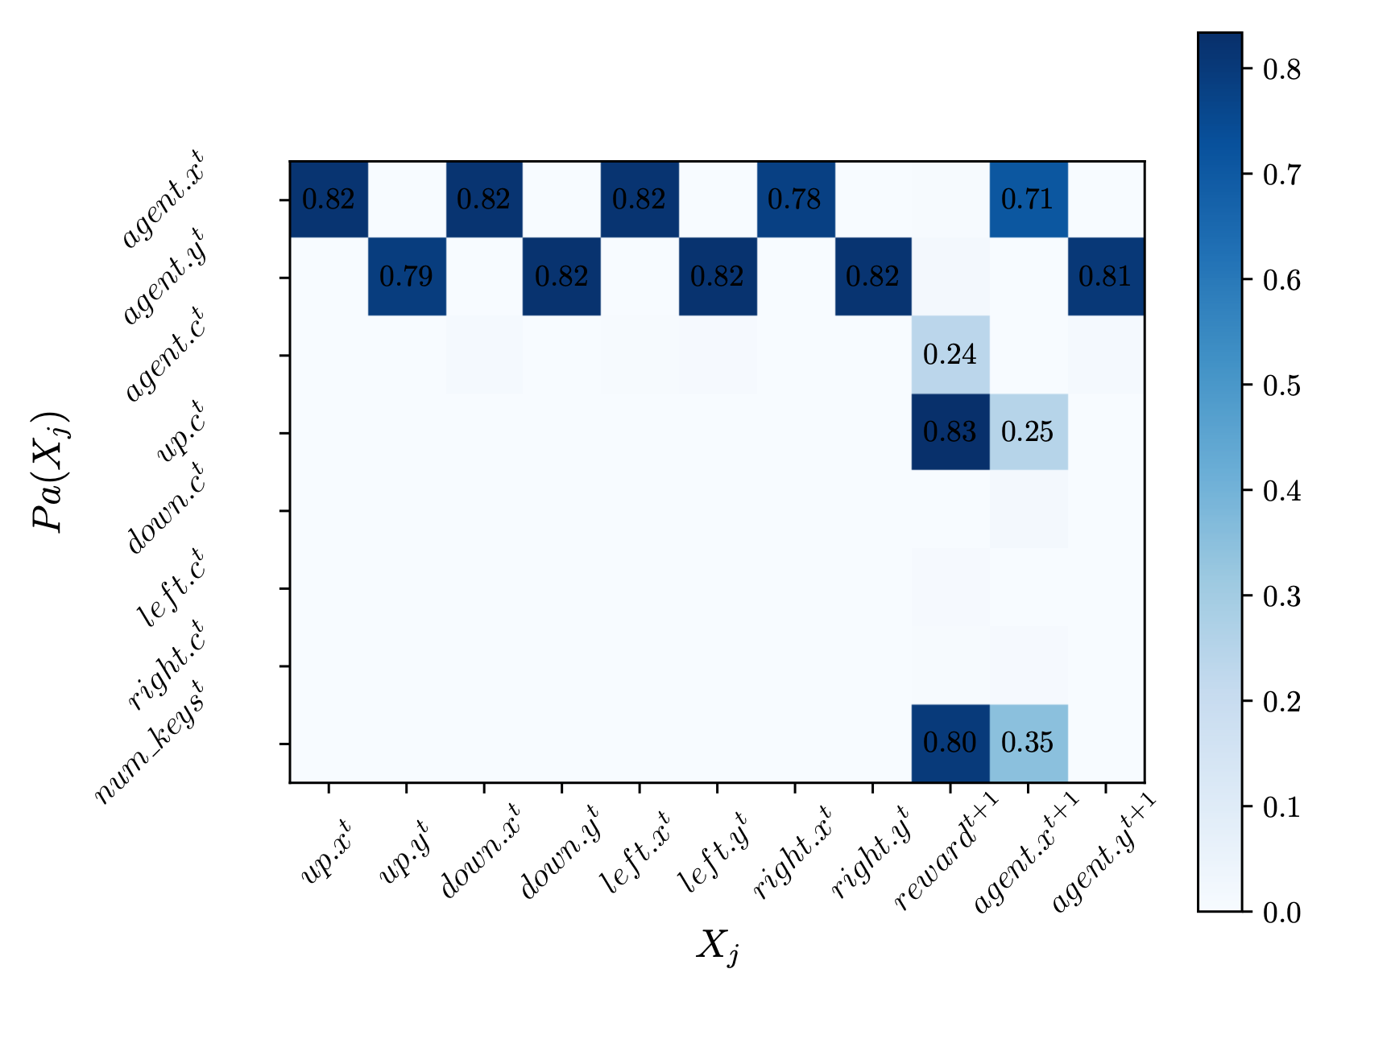
Experimental Evaluation
Structure Learning
Figure 3: $L_{2}$ norm of weight values for learned bayesian graph $G^{up}$ for action ${}^{′}UP^{′}$. Attributes on y-axis are potential parents (causes) of the corresponding $j_{th}$ attribute on x-axis ($X_{j}$), with parameters j . Positive values of weights indicate edge between parents and children

Slide 9
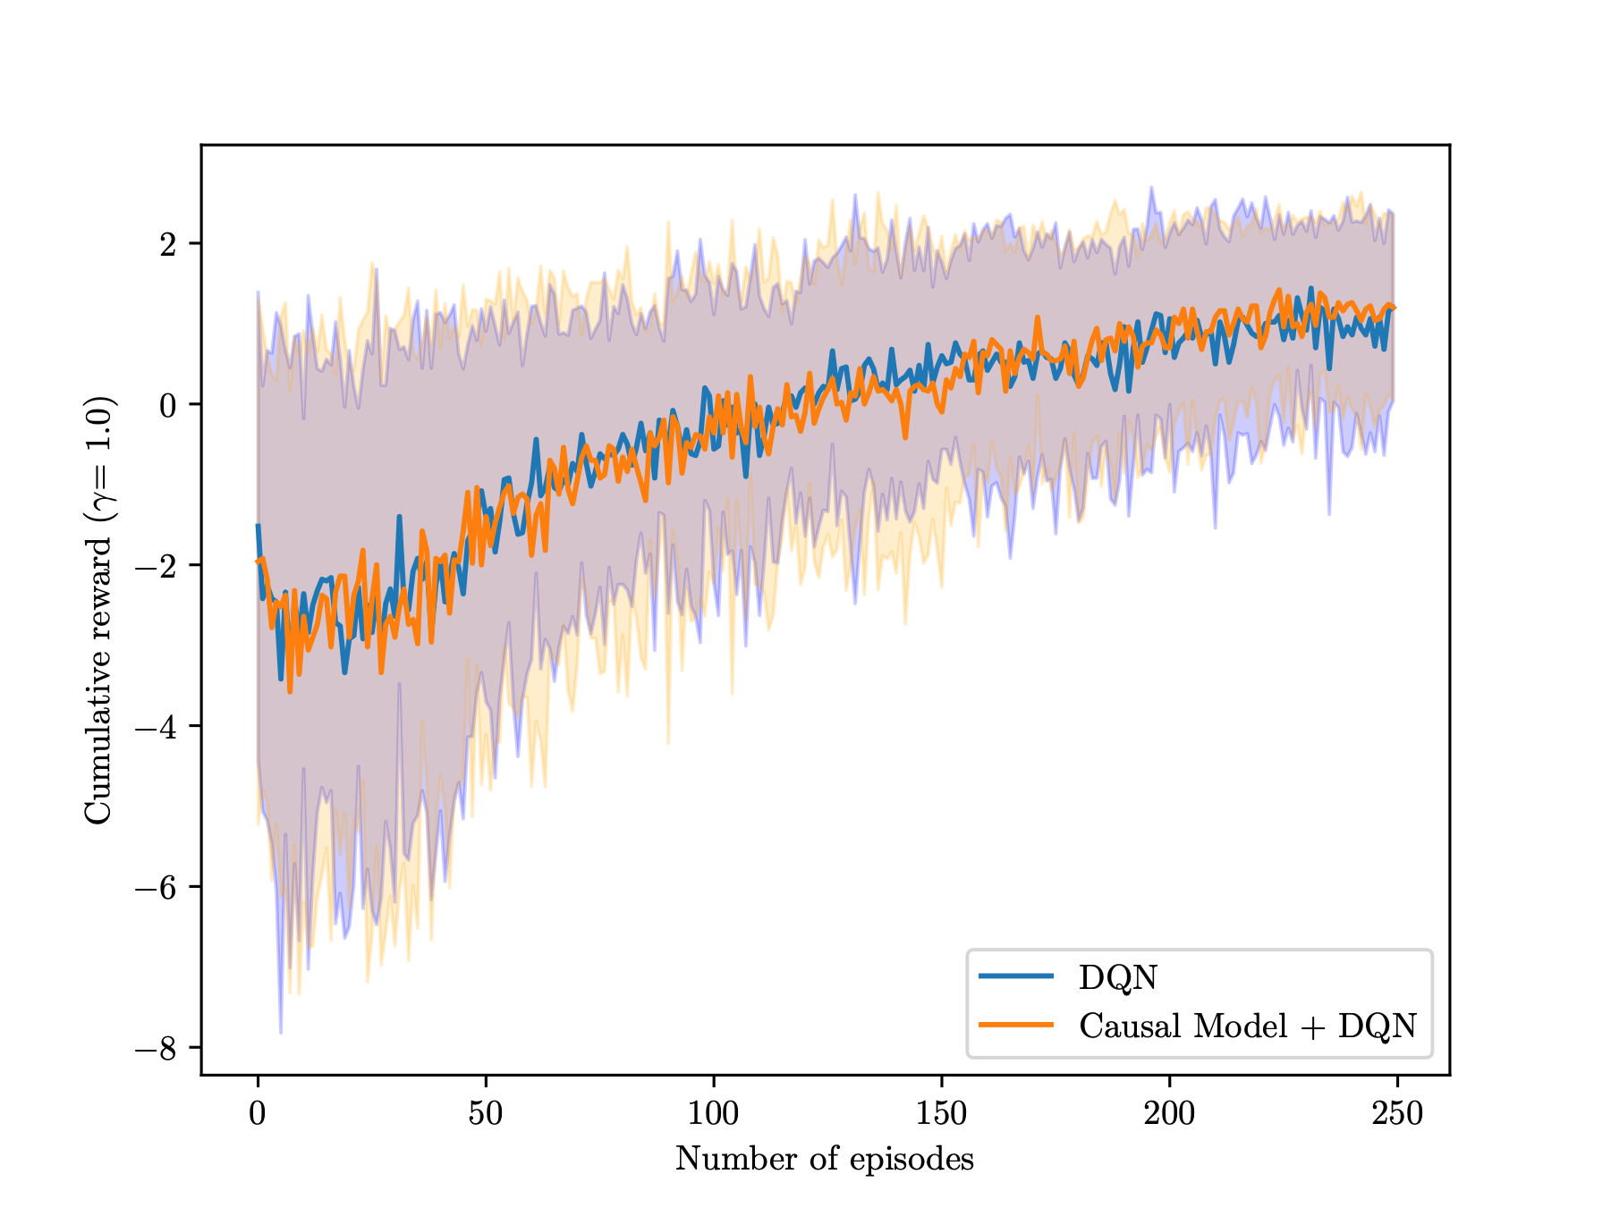
Experimental Evaluation
Causal Dynamics Model Based Planning
Figure 4: Planning using Causal-Dynamics Model

Slide 10
Future Work
Conclusion and Discussion
Evaluation of structure mapping in real-world environments.
Learning object-oriented representation for complex domains with continuous action and state spaces.
Limited intervention setting and use of largely available observational data.
Matching distributed representations (e.g. deep embeddings) for attributes.

Slide 11
Thank You!
Purva Pruthi
ppruthi@umass.edu
Xiaoyu Lu
luxiaoyu@amazon.com
Javier González
Gonzalez.Javier@microsoft.com
Madalina Fiterau
mfiterau@cs.umass.edu

